Slide 1
BEAM: Periscope Lesson
Caroline Quan

Slide 2
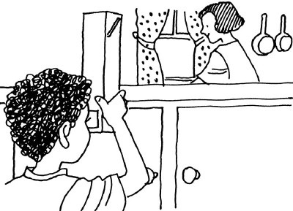
Brief Overview/Challenge
Build a periscope.

Slide 3
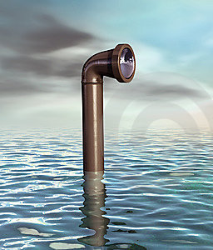
Background
Periscope, an optical device used for viewing objects that are out of the line of sight.
Periscopes are used in tanks and submarines where it is necessary to see from a protected position. They have also been used for viewing the interiors of nuclear reactors.
A simple periscope consists of a tube and two mirrors. The mirrors are set at angles of 45° to the length of the tube. If the mirrors are parallel to each other, the periscope "looks" forward and the object seen is rightside-up. In high-quality periscopes, reflecting prisms are often used instead of mirrors.

Slide 4
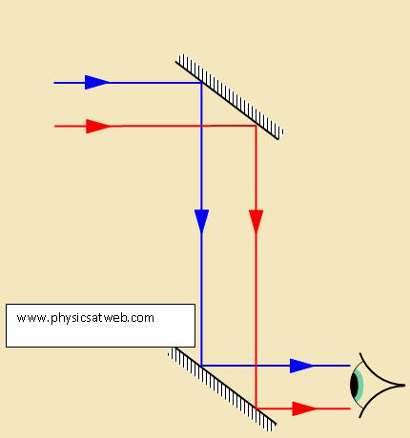
Teaching Goals
Learn about physics/optics.
Understand the Law of Reflection and how mirrors work.

Slide 5
Agenda
Introduction (~10-15 min)
Introduce the lesson
1. Ask if anyone knows what a periscope is.
2. Talk about periscopes and relate them to real life (submarines)
3. Go over instructions on how to build the periscope.
4. Have materials ready to be passed out.

Slide 6
Agenda
Build (~30 min)
Distribute materials.
Have mentors help the students if necessary. Answer questions. Mainly let the students have free reign unless they ask for help.
Let students test their periscopes.

Slide 7
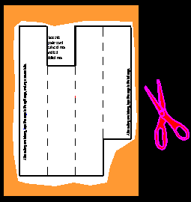
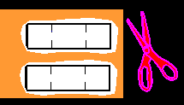
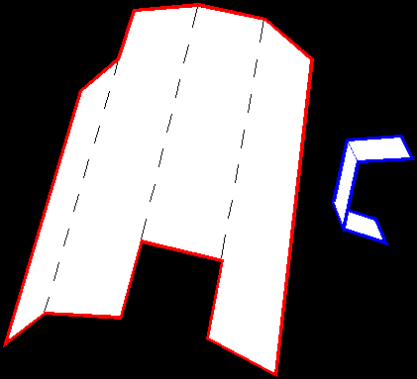
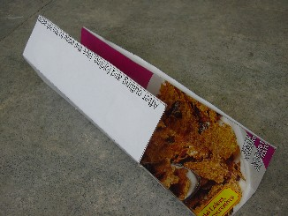
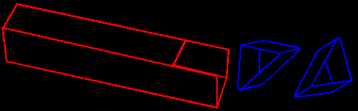
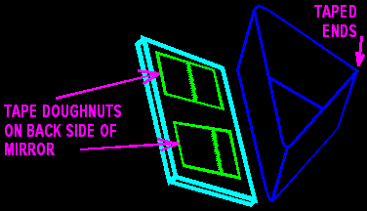
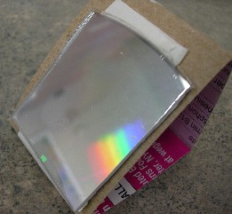
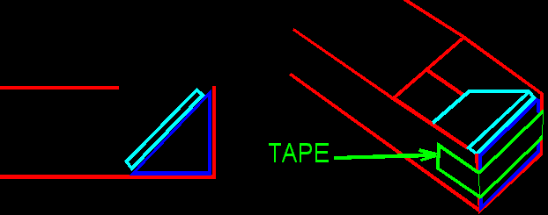
Agenda
Procedure for building:
Cut out the periscope body and triangular mount templates.
Fold and tape the templates.
Tape the mirrors to the mounts and the mounts to the periscope.

Slide 8
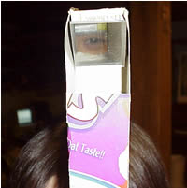
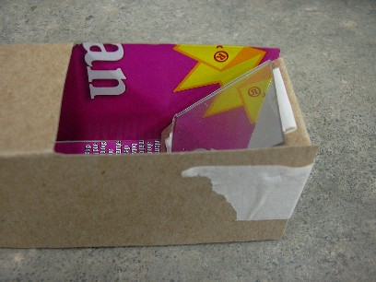
Agenda
The final product should look something like this:

Slide 9
Agenda
Recap (10-15 min)
Ask if everyone was able to make their periscope.
Fun fact: periscopes in tanks and submarines have magnifying lenses between the mirrors to make the reflected image bigger.
Ask what would change if you changed the length of the periscope.
A. The longer the tube is, the smaller the image you’ll see.

Slide 10
Materials
Each student will make their own periscope.
Periscope Materials (per each student)
Periscope paper template printed on cardstock (standard 8.5 by 11 in)
2 mirrors (~1.5 in squares/can be any shape)
Scissors
Tape

Slide 11
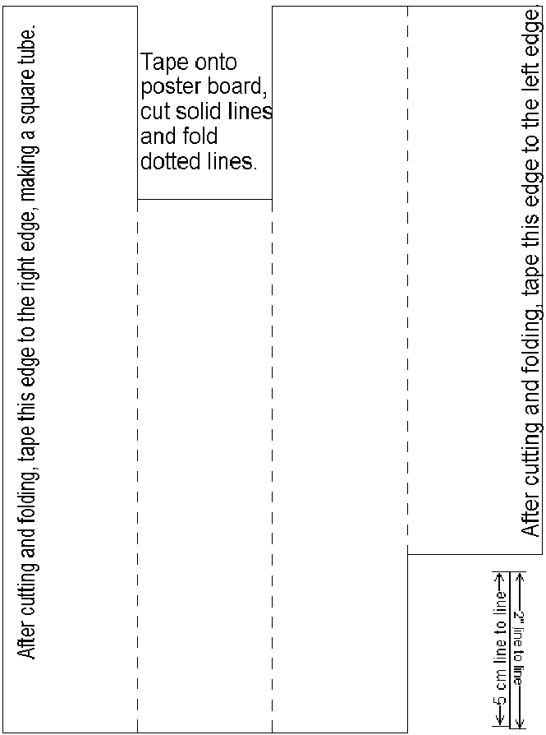
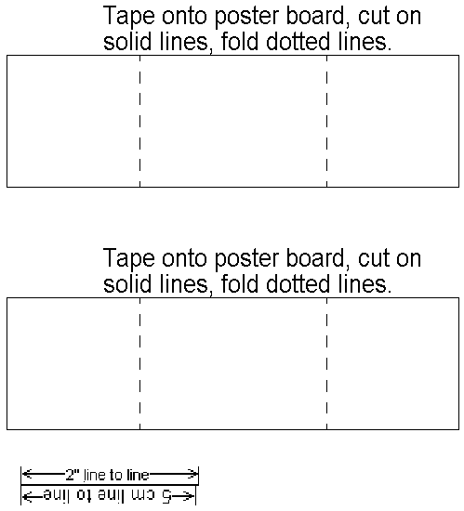
Materials
TEMPLATES
(Periscope body) http://www.sciencetoymaker.org/periscope/images/periscpBody.gif
(Triangular cutouts) http://www.sciencetoymaker.org/periscope/images/periscopTri.gif

Slide 12
Procedure/Tips for building
Cut out the periscope body and triangular mounts
-Make sure students do not cut on the dotted lines
Fold both the periscope body and the triangle mounts on the dashed lines. Do it on the sharp edge of a desk.
-Kids may have a hard time applying enough pressure to make the fold while at same time trying to be accurate and stay on the dashed line so encourage them to help each other for this part.
Tape the mirrors to the mounts and the mounts to the periscope.
-The mirrors have to be taped to the hypotenuse of the triangle. This is the longer side opposite the taped ends. The triangles are right triangles (have a 90 degree angle), isosceles (have 2 sides of equal length) and they have two 45 degree angles.

Slide 13
Material to Teach
How a Periscope Works:
Light always reflects away from a mirror at the same angle that it hits the mirror. In your periscope, light hits the top mirror at a 45-degree angle and reflects away at the same angle, which bounces it down to the bottom mirror. That reflected light hits the second mirror at a 45-degree angle and reflects away at the same angle, right into your eye.

Slide 14
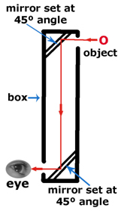
Material to Teach
Why the mirrors have to be at a 45-degree angle:
-When you aim a light source to a mirror, it gets reflected in the following way:
the angle of incidence respect to the perpendicular of the mirror's surface is equal to the angle of reflection so if you aim it at 45 degrees, it would get reflected 45 degrees the other way, adding to a total of 90 degrees (best to show this with a diagram)

Slide 15
Material to Teach
About Mirrors in General (if you have time)
Law of reflection
1) The incident ray, reflected ray, normal lies on the same plane.
2) θ_{i} = θ_{r}, i.e., the angle of incidence is equal to the angle of reflection.
When the light rays are stroked on a curved mirror, the normal is perpendicular to the tangent of the curve at that point. e.g., when parallel rays are stroked on a coven mirror, they are all reflected and converge in front of the mirror.
(It may be helpful to draw the diagram below on a board.)

Slide 16
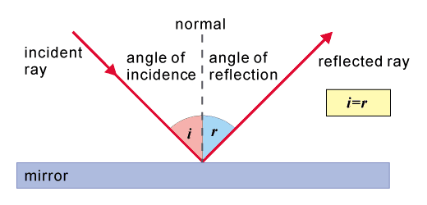
Material to Teach
(It may be helpful to draw the diagram below on a board.)

Slide 17
Material to Teach
Properties of the image: the object that we see through the mirror is not the real position of it, but we can imagine that the light rays from the object comes behind the mirror and we call that an image. They have the properties:
1) Distance from image/object to the mirror is equal. i.e., image distance is equal to object distance.
2) IO is perpendicular to the mirror.
3) The image formed is laterally inverted, of the same size as the object and is virtual.

Slide 18
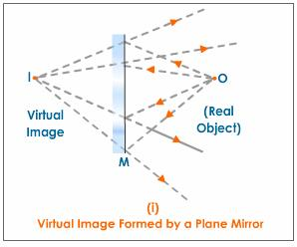
Material to Teach

Slide 19
References
http://allmaths.blogspot.com/2011_01_13_archive.html
http://www.sciencetoymaker.org/periscope/asmblCD.htm

